Slide 1
Steel defect detection in microscopic images
Ou Jin
September 2019

Slide 2
Outline:
Project goal and dataset
Data wrangling
Exploratory data analysis
Deep learning: image segmentation
UNET architecture
Results
Discussion and next steps

Slide 3
Project goal and dataset
Use machine learning models to detect steel manufacturing defects in microscopic images.
May help automate defect detection process and increase accuracy.
12568 training images are provided at Kaggle website below, as an ongoing competition.
https://www.kaggle.com/c/severstal-steel-defect-detection
Defect location and defect class info are provided in a csv file, in Run-Length Encoding (RLE) format
Each image can have no defect, one class of defect or up to four classes of defects

Slide 4
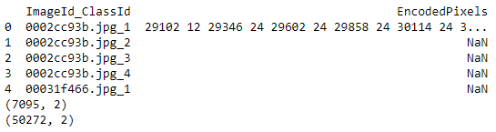
Data wrangling
This is a semantic image segmentation problem
Provided CSV file has 50272 lines (12568 images X 4 defect classes), in which 7095 lines have defect info. The other lines have no defect.
ImageId and ClassId info needs to be separated for modeling.
A mask image needs to be generated for each Image ID and Defect Class combination. This is done using a rleToMask function.

Slide 5
Exploratory data analysis
Each image has 256 by 1600 pixels, and 3 color channels
This is a classification problem with very imbalanced class data
12568 images in total
897 images with class 1 defect
247 images with class 2 defect
5150 images with class 3 defect
801 images with class 4 defect
Defect area usually occupies a small portion of the entire image. So in general defect pixels are a very small fraction of total number of image pixels for all 4 defect classes.

Slide 6
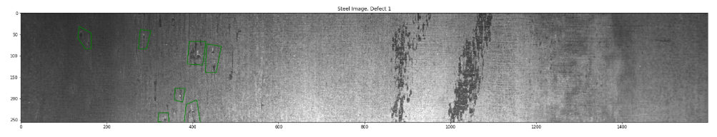
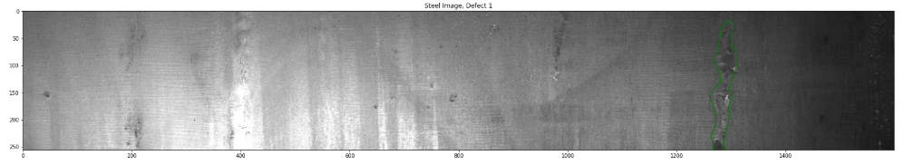
Exploratory data analysis: example images-Defect 1

Slide 7
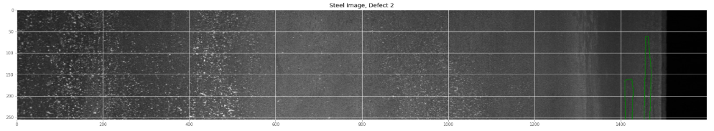
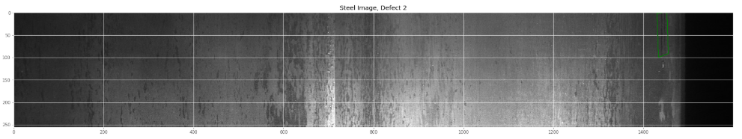
Exploratory data analysis: example images-Defect 2

Slide 8
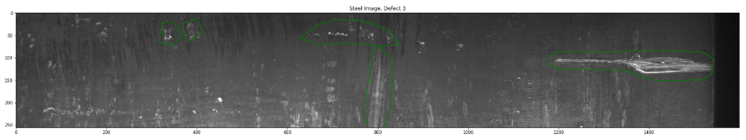
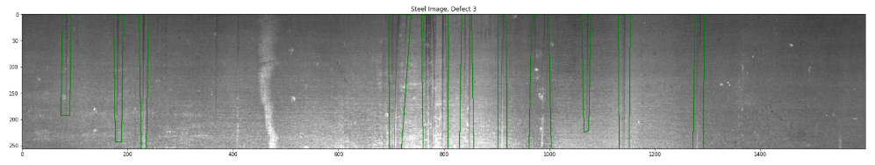
Exploratory data analysis: example images-Defect 3
Defect 3 appears to be groups of scratches

Slide 9
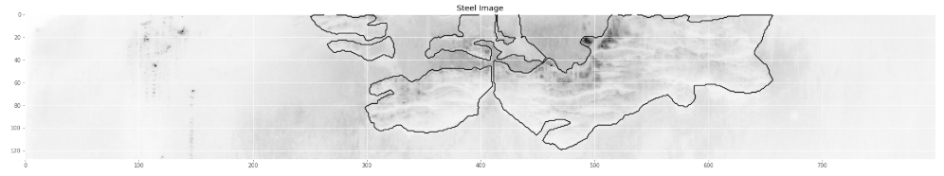
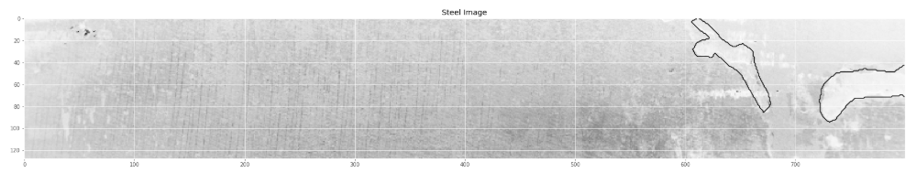
Exploratory data analysis: example images-Defect 4
Defect 4 appears to be in surface patches

Slide 10
Deep learning
A CNN architecture called UNET is selected for image segmentation
UNET was developed in ‘2015 by Olaf Ronneberger, et al and won the ISBI cell tracking challenge.
The architecture consists of a contracting path (convolution + pooling) to capture context and a symmetric expanding path (transpose convolution) to enable precise localization.
Architecture is shown on next slide
It can be easily adapted to other input image size

Slide 11
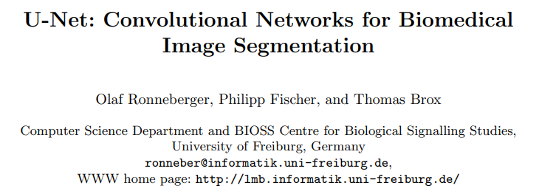
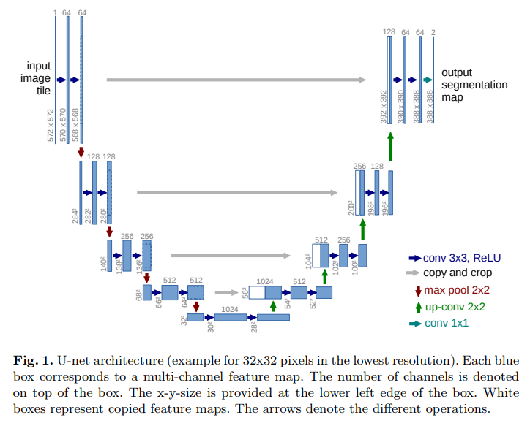

Slide 12
Deep learning
Due to computer memory limitation, we downsized input images and masks from 256X1600 to 128X800 pixels for modeling.
Four models were trained separately, each for a single defect class
Due to easier implementation
And computer memory and performance limitation (CPU was used as GPU is not available)
Data is very imbalanced with a small fraction of defect pixels. Binary accuracy and cross-entropy are not ideal metrics for model performance.
Dice Coef is used as loss function; Diff is used as one of the metrics besides binary accuracy.

Slide 13
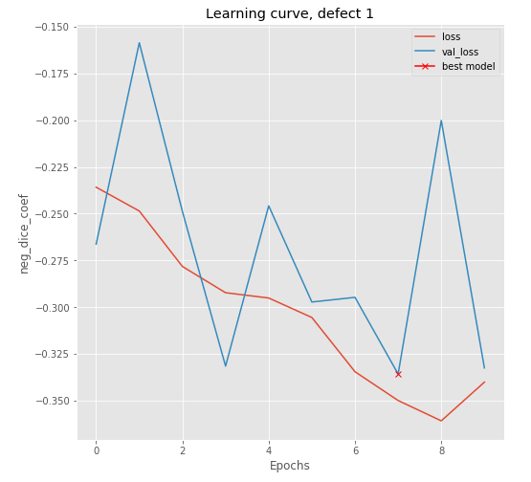
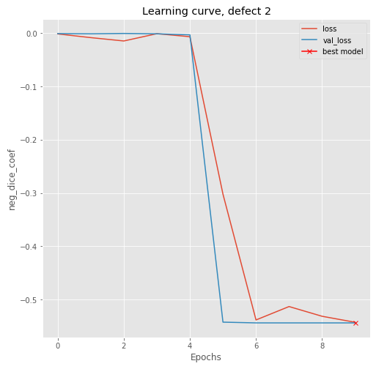
Results: learning curves for Defect 1 and 2

Slide 14
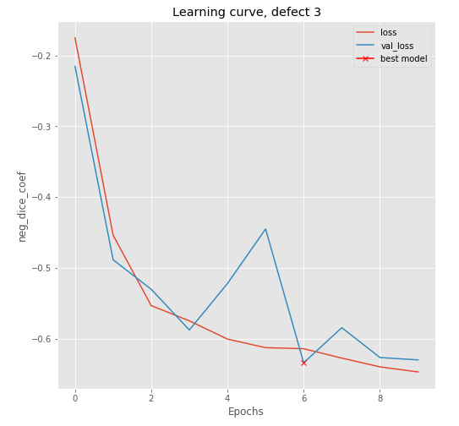
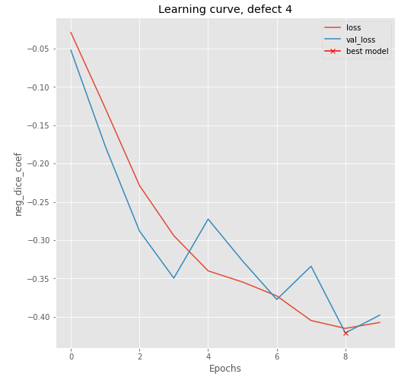
Results: learning curves for Defect 3 and 4

Slide 15
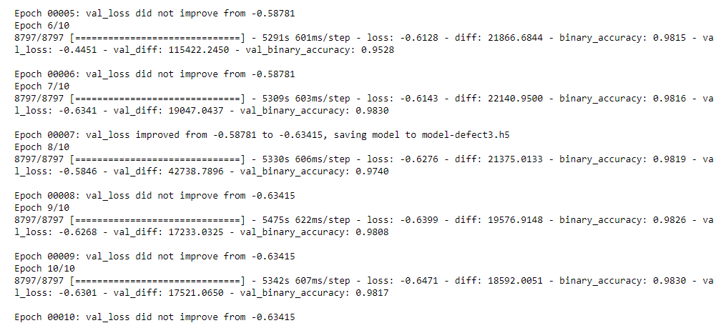
Results: example metrics
This screen capture is from Defect Class 3

Slide 16
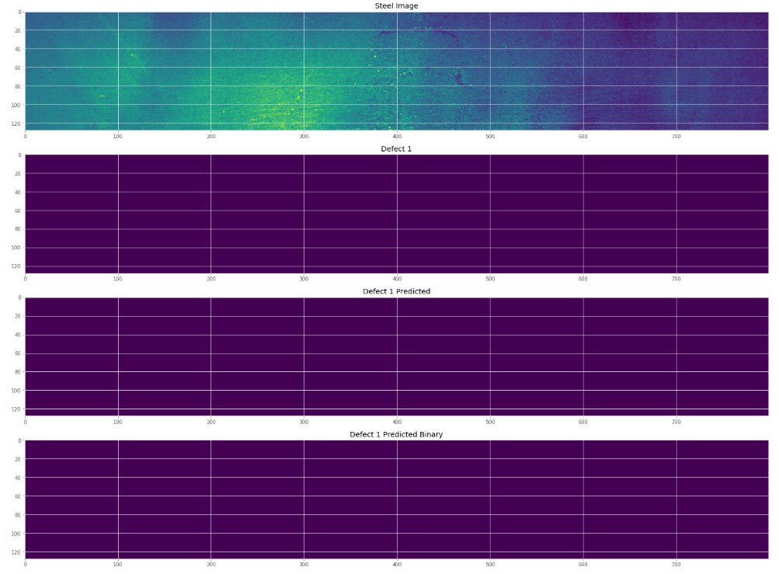
Examples of Defect 1 images
Ground truth mask
Predicted mask

Slide 17
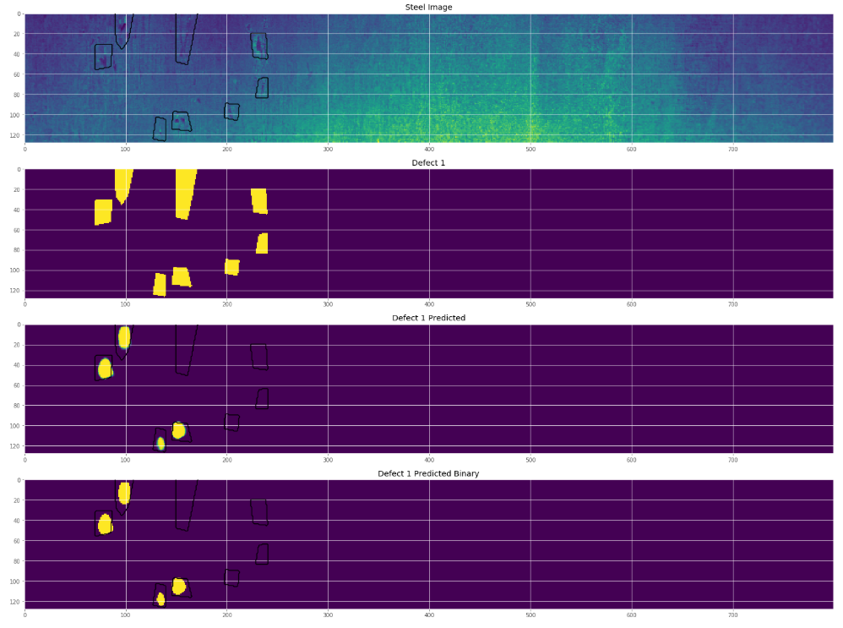
Examples of Defect 1 images
Ground truth mask
Predicted mask

Slide 18
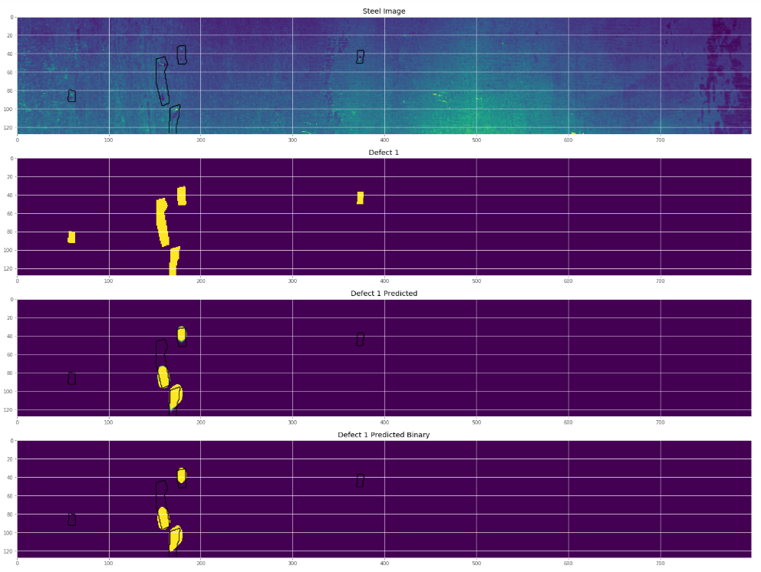
Examples of Defect 1 images
Ground truth mask
Predicted mask

Slide 19
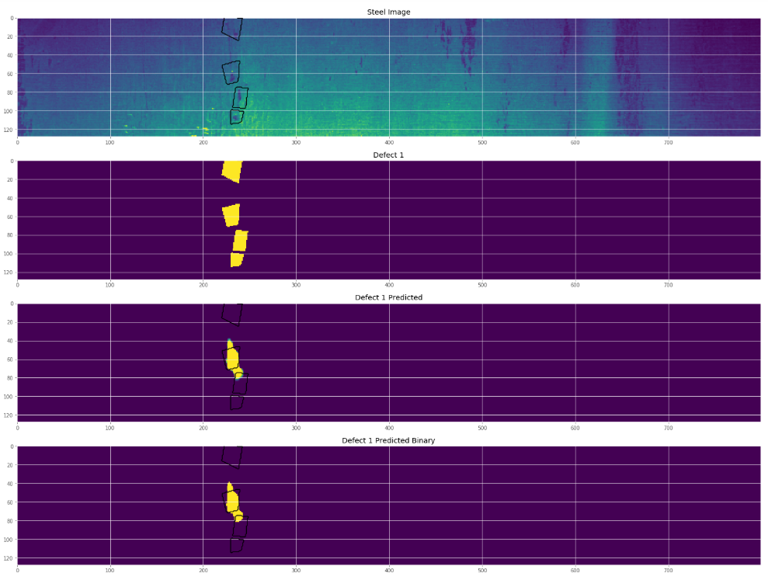
Examples of Defect 1 images
Ground truth mask
Predicted mask

Slide 20
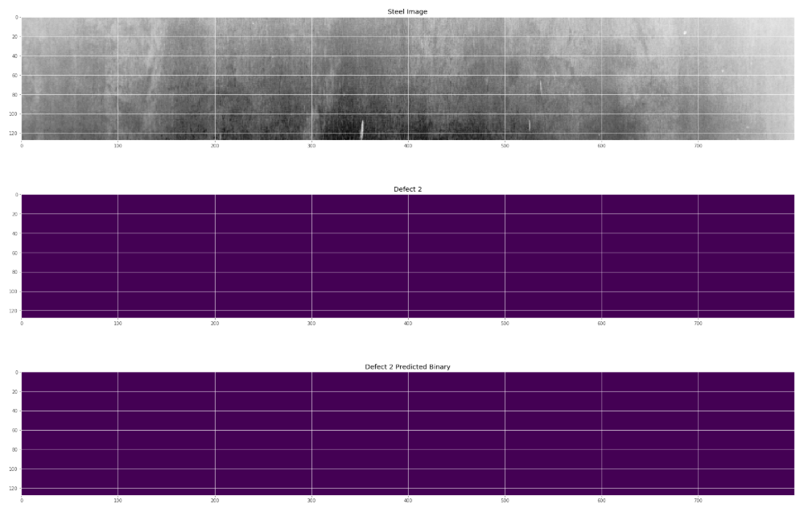
Examples of Defect 2 images
Ground truth mask
Predicted mask

Slide 21
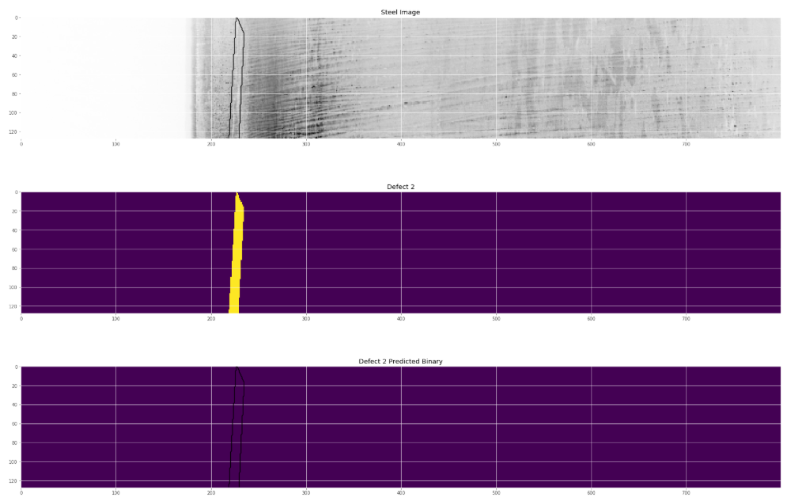
Examples of Defect 2 images
Ground truth mask
Predicted mask

Slide 22
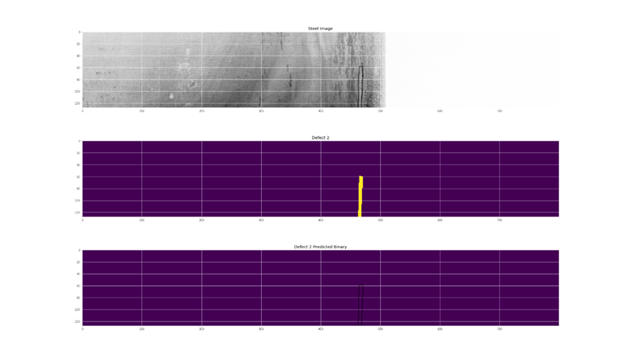
Examples of Defect 2 images
Ground truth mask
Predicted mask

Slide 23
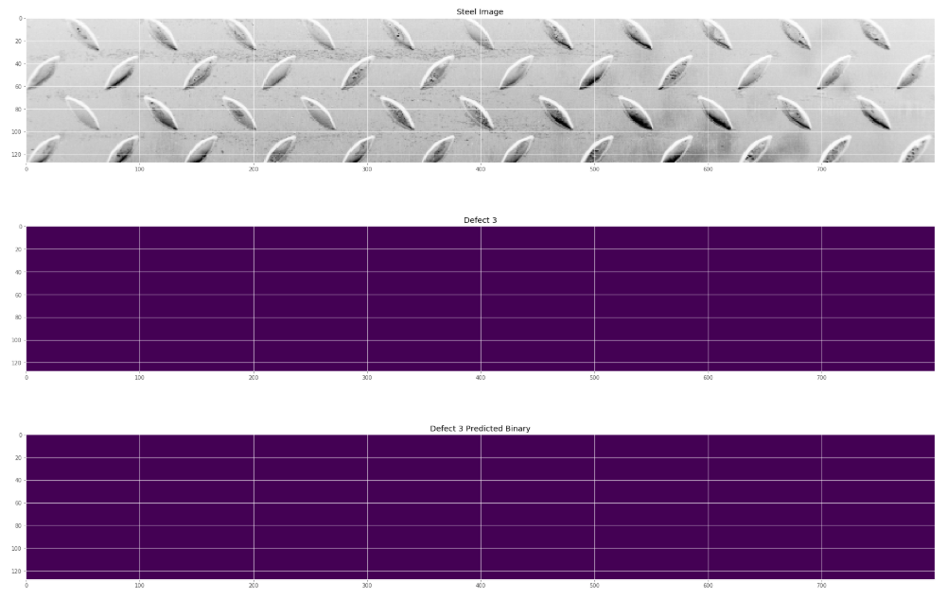
Examples of Defect 3 images
Ground truth mask
Predicted mask

Slide 24
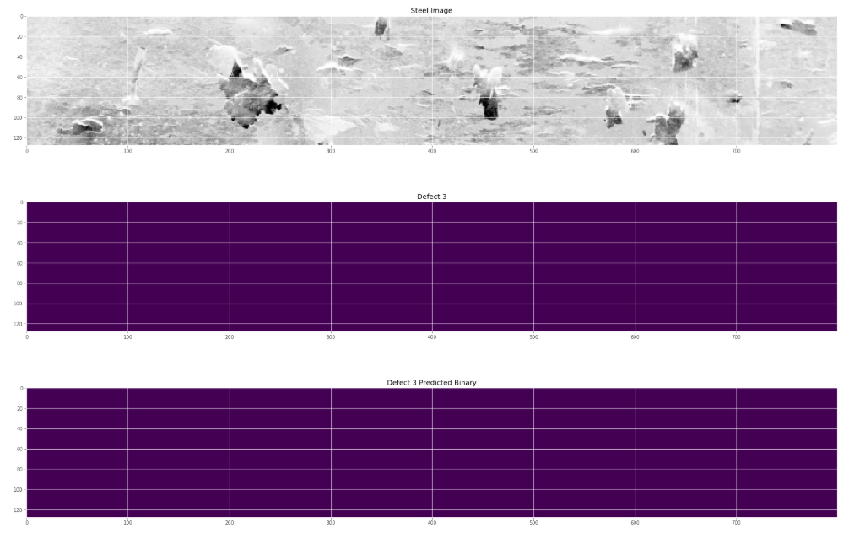
Examples of Defect 3 images
Ground truth mask
Predicted mask

Slide 25
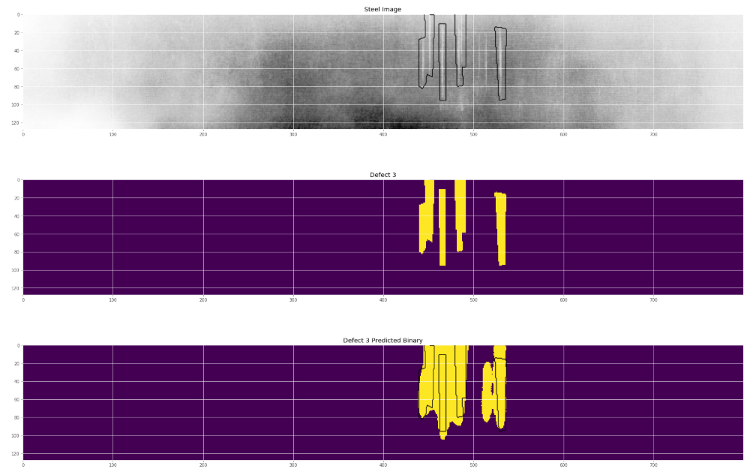
Examples of Defect 3 images
Ground truth mask
Predicted mask

Slide 26
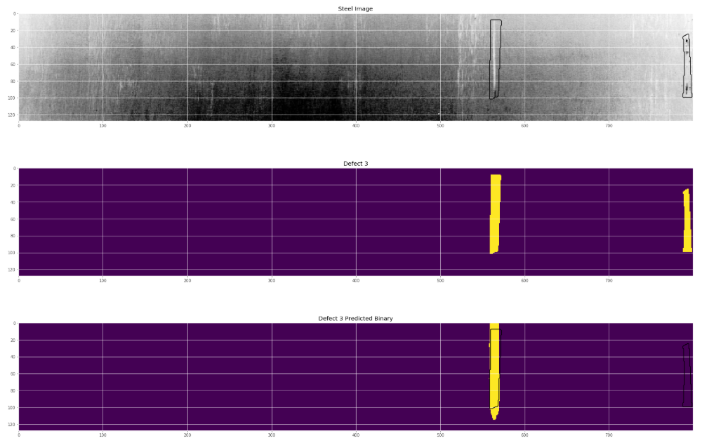
Examples of Defect 3 images
Ground truth mask
Predicted mask

Slide 27
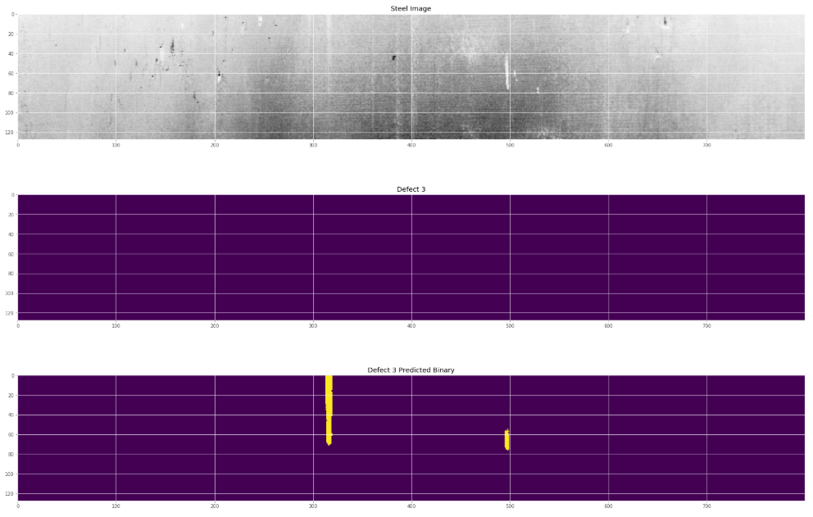
Examples of Defect 3 images
Ground truth mask
Predicted mask

Slide 28
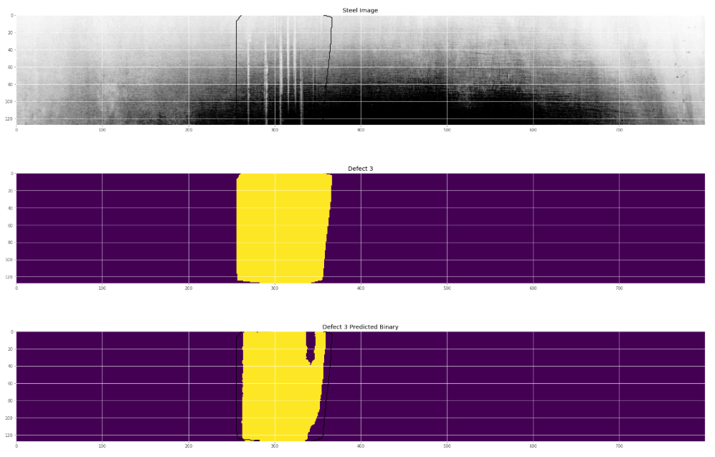
Examples of Defect 3 images

Slide 29
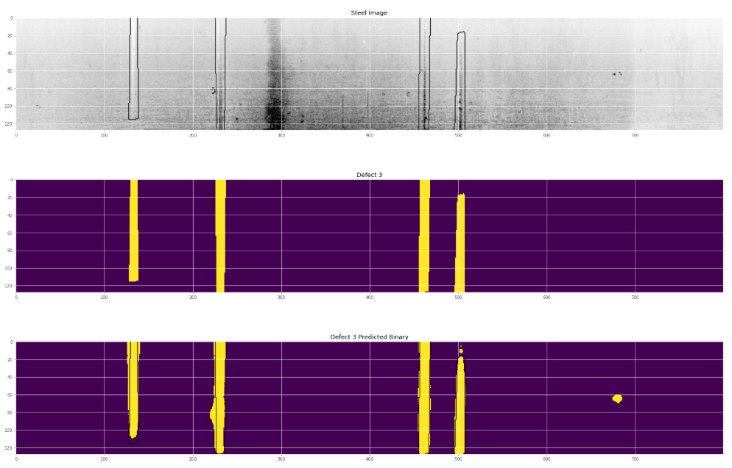
Examples of Defect 3 images
Ground truth mask
Predicted mask

Slide 30
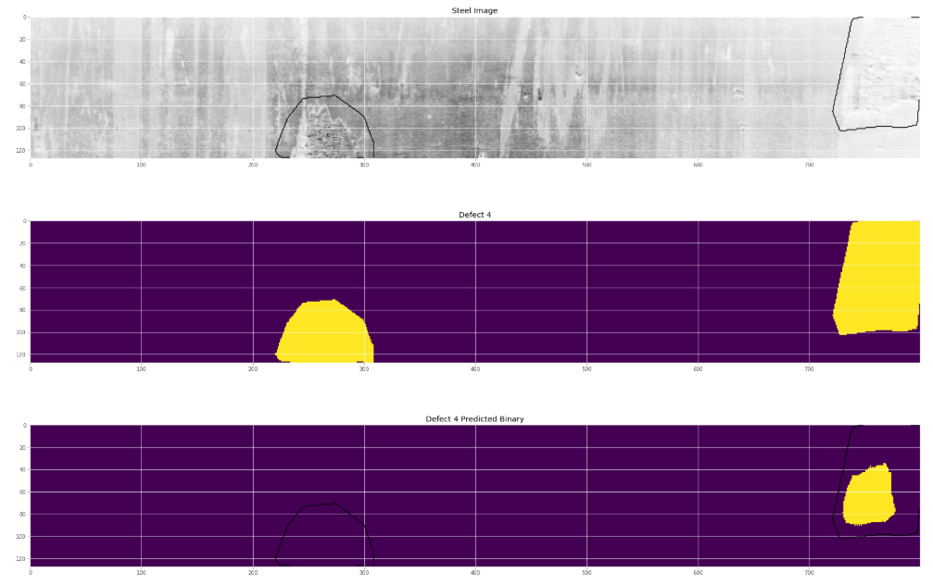
Examples of Defect 4 images
Ground truth mask
Predicted mask

Slide 31
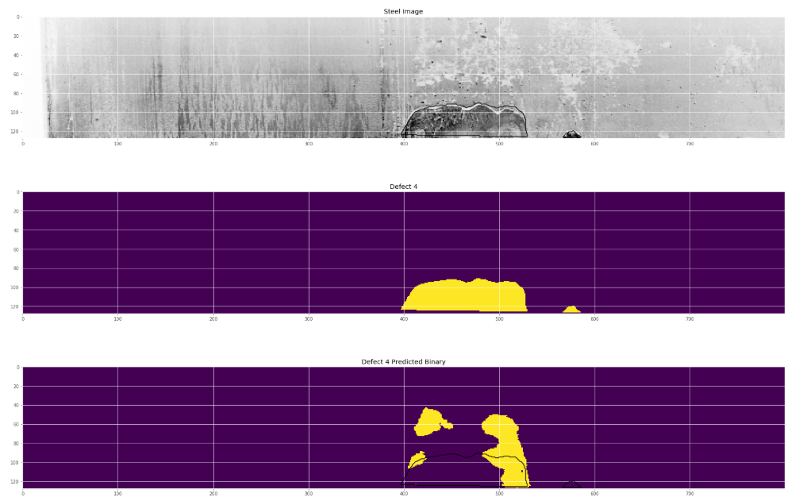
Examples of Defect 4 images
Ground truth mask
Predicted mask

Slide 32
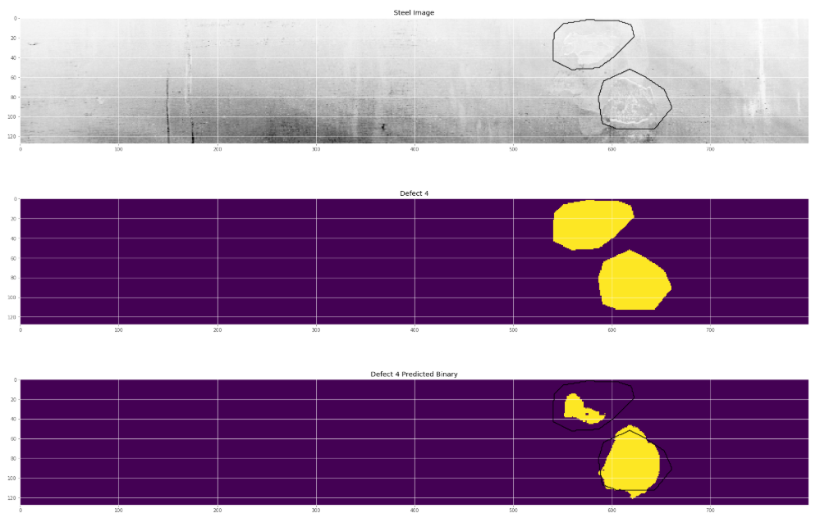
Examples of Defect 4 images
Ground truth mask
Predicted mask

Slide 33
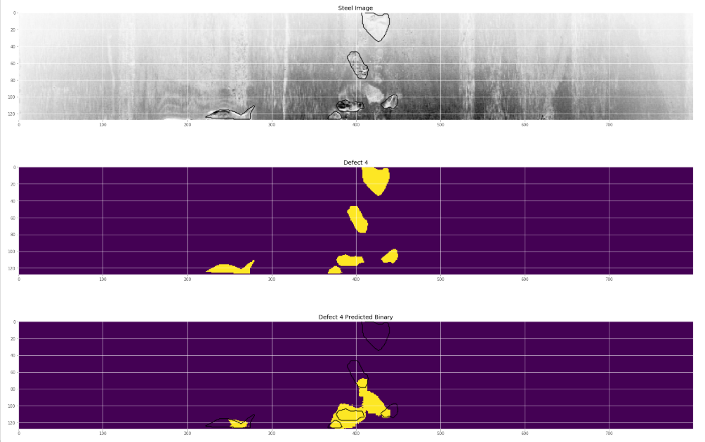
Examples of Defect 4 images
Ground truth mask
Predicted mask

Slide 34
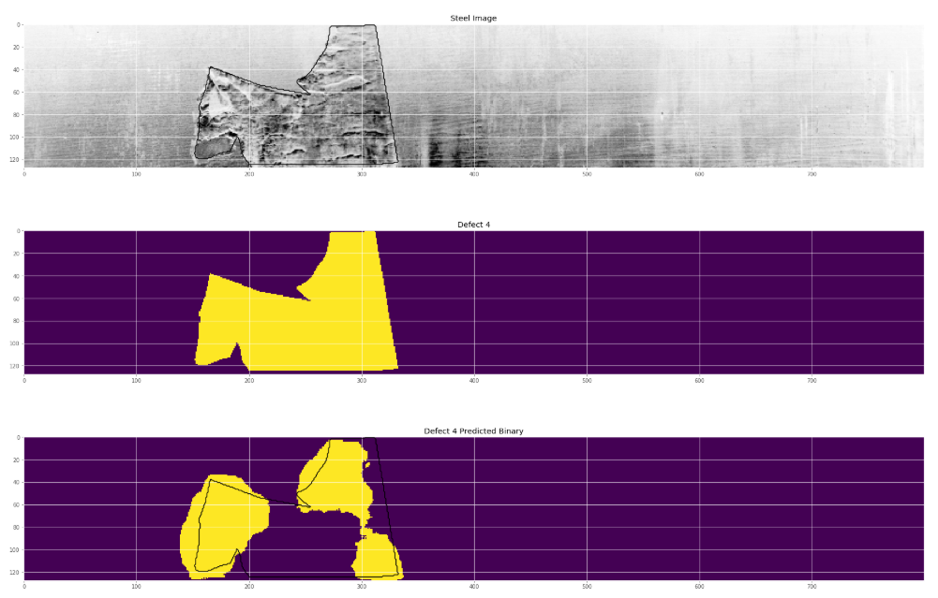
Examples of Defect 4 images
Ground truth mask
Predicted mask

Slide 35
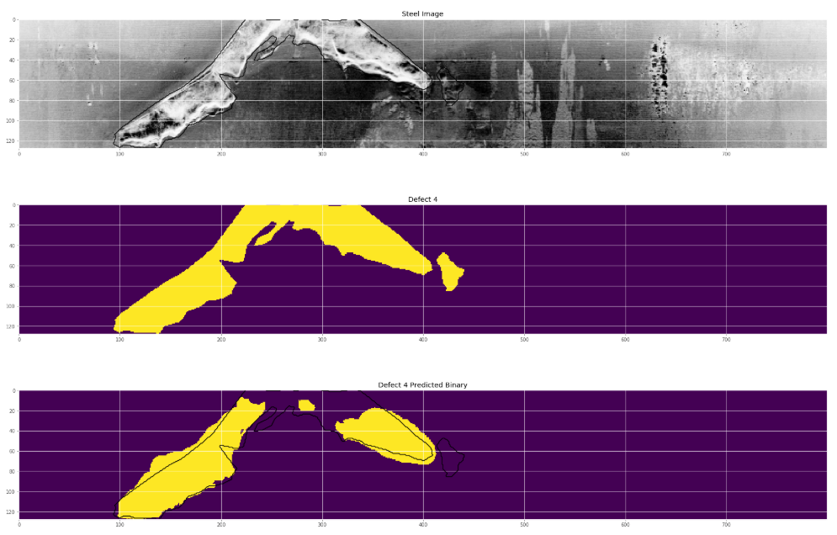
Examples of Defect 4 images
Ground truth mask
Predicted mask

Slide 36
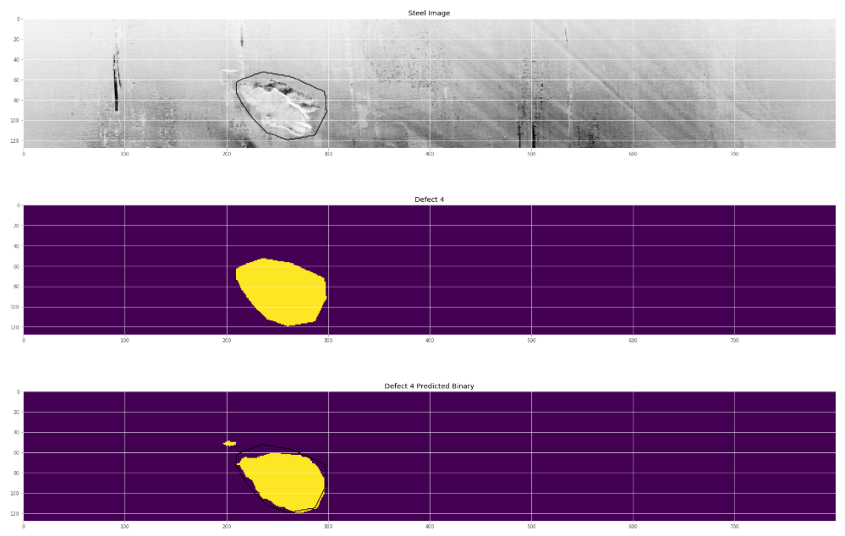
Examples of Defect 4 images
Ground truth mask
Predicted mask

Slide 37
Mean Dice Coef for every imageID and defectClassID combination in validation data (30% of training data)
Defect Class | Mean Dice Coef | Total Defect Images in Training | Total Images
1 | 0.876 | 897 | 12568
2 | 0.838 | 247 | 12568
3 | 0.662 | 5150 | 12568
4 | 0.891 | 801 | 12568
Overall | 0.817

Slide 38
Discussion and next steps
Mean dice coef of each imageID and classID combination on validation data is 0.817.
No Defect 2 was predicted by model, however the learning curve shows a suddenly drop of dice coef to below -0.5 after 4 epochs. This behavior is not fully understood and needs follow-up investigation. It is believed to be related to choosing dice coef as loss function and back propagation has problem calculating gradient. Tried to use binary cross-entropy as loss function but still could not predict any Defect 2.

Slide 39
Discussion and next steps
To further improve model performance, more research and tests can be done
To investigate if there are other promising and better neural network architectures
To reduce filter size to hopefully better capture small defect features
To increase number of filters in convolution
To tune pooling stride and drop out rate
If computer memory and power allows, use original 256X1600 pixel images for training instead of downsizing to 128X800 pixels as we did
To figure out a way to fit a multi class model to predict all 4 defect classes in one model
To optimize code to improve model performance
To run more epochs on a GPU machine

